Slide 1
Applied Finance Project
Improving TAA Signals for HOD Group
Advisor: Professor Levon Goukasian
Company Contact: Elisabetta Basilico
Team:
Luka Vidovic
Rajesh Pothamsetty
Sandeep Reddy Voruganti
Koushik Boddireddy

Slide 2
CONTENTS
Background
Objective
Added Signals
Dual Momentum
Variance Risk Premium
Conclusion

Slide 3
Background
HOD Group: Financial advisory in Luxembourg, Switzerland
Employs full scale optimization across ten index funds
In process of devising a tactical asset allocation strategy to avoid market crashes
US Equities | Corporate Bonds
International Equities | Real Estate
Emerging Market Equities | Commodities
Low Beta Equities | Hedge Funds
Government Bonds | Cash

Slide 4
Background (Benchmark)
High
Medium
Low
Rebalancing Frequency
Monthly
Weekly
Daily

Slide 5
Background (continued)
2015: Implemented three signals
Absorption Ratio
Time Series Momentum
Simple Moving Average
2015 Signal Results (First 3 Signals)
January 2007 to August 2015

Slide 6
CONTENTS
Background
Objective
Added Signals
Dual Momentum
Variance Risk Premium
Conclusion

Slide 7
Objective
SAA
SAA
AR
AR
DualMom
TSMOM
SMA
VRP
TSMOM
SMA
SAA
2016
Investigate potential for adding signals based on dual momentum and implied volatility
2015
SAA
Tactical Asset Allocation

Slide 8
Testing periods
In Sample
January 2007 to August 2015
Out of Sample
September 2015 to July 2016

Slide 9
CONTENTS
Background
Objective
Added Signals
Dual Momentum
Variance Risk Premium
Conclusion

Slide 10
Dual momentum
$$Dual Momentum=Absolute Momentum+Relative Momentum$$
Enhances return
Stochastic dominance over relative and absolute momentum
No evidence of reducing volatility
Gets in the way of diversification

Slide 11
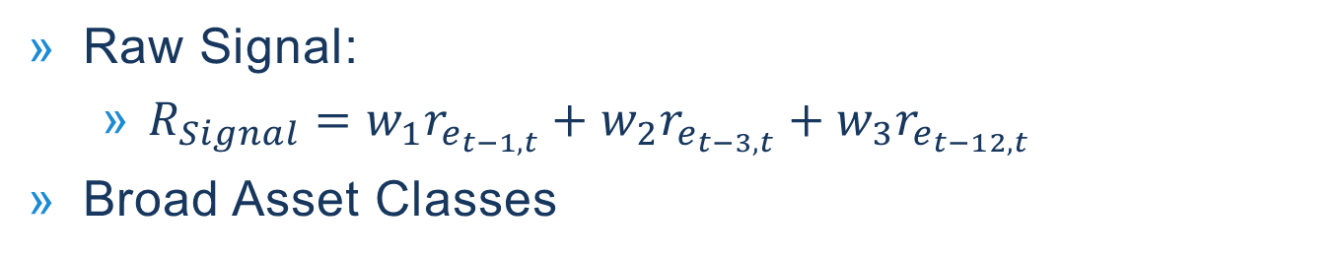

First implementation
Raw Signal:
$R_{Signal}=w_{1}r_{e_{t−1,t}}+w_{2}r_{e_{t−3,t}}+w_{3}r_{e_{t−12,t}}$
Broad Asset Classes
Equities | Bonds | Real Estate and Commodities
US | Government | Real Estate
International Developed | Corporate | Commodities
Emerging Markets
$If R_{Signal}>0 and R_{Signal}={max⁡(R}_{{Signal}_{BAC}}),$
$$signal=0, else signal=1$$

Slide 12
First Implementation(Equity)

Slide 13
First implementation (non-equity)

Slide 14
First implementation (Issues)
Problem
Solution
Don’t move weights to cash
Move total weight of broad asset class (Equities, Bonds,…) to asset with dual momentum signal of zero in broad asset class group.
Dual Momentum adding very little value
Too much allocation towards cash

Slide 15


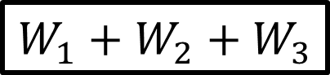

Revised implementation (simple Example)
Equities
United States
International
Emerging Markets
SAA
Weight
$$W_{1}$$
$$W_{2}$$
$$W_{3}$$
Weighted Prev. Return
5%
7%
3%
TAA
Weight
0%
$$W_{1}+W_{2}+W_{3}$$
0%

Slide 16
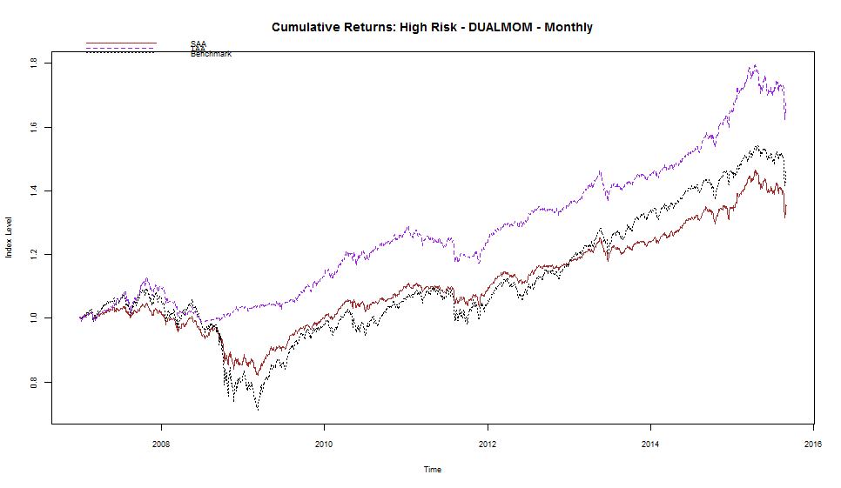
In sample high risk Individual dual momentum results
SAA
TAA
Benchmark

Slide 17
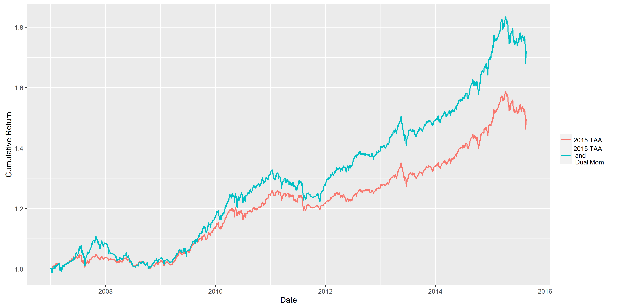
In sample high risk combined dual momentum

Slide 18
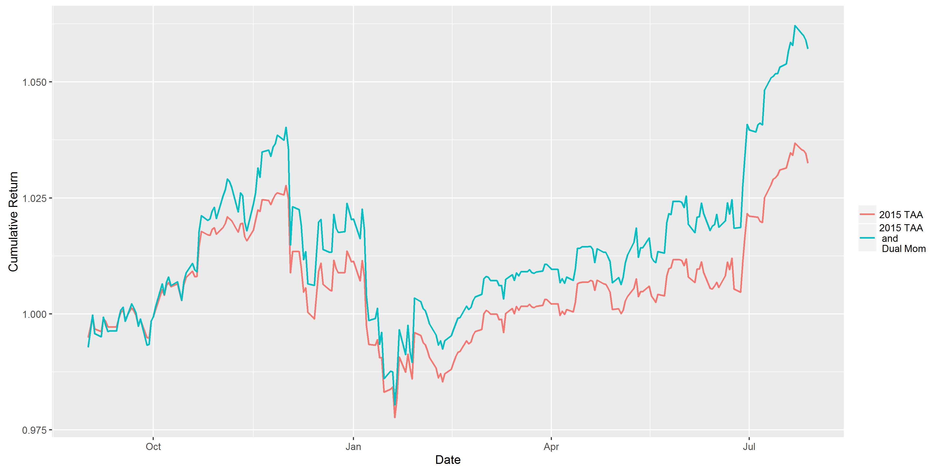
Out of sample high risk combined dual momentum

Slide 19
Dual momentum summary
Significant increase in returns and Sharpe ratio
Still maintain low volatilities and drawdowns
Nice addition even though it does not decrease risk significantly

Slide 20
CONTENTS
Background
Objective
Added Signals
Dual Momentum
Variance Risk Premium
Conclusion

Slide 21
Variance Risk premium (vrp)
To improve the equity market timing ability. Equity risk premia has a short run component – VRP.
Empirical proxy constructed as difference between options-implied variance and realized variance.
Intuition: When VRP is significantly positive, implies investors are expecting higher volatility than the existing volatility or a tail event.
Investors need to be compensated for taking this risk. Hence higher VRP predicts higher future returns.
VRP leads equity markets, especially during crisis (few examples).
Notes:
Market timing was considered to impossible in the earliest literatures but with recent abundance of data at varying frequencies
VRP is not directly observable

Slide 22
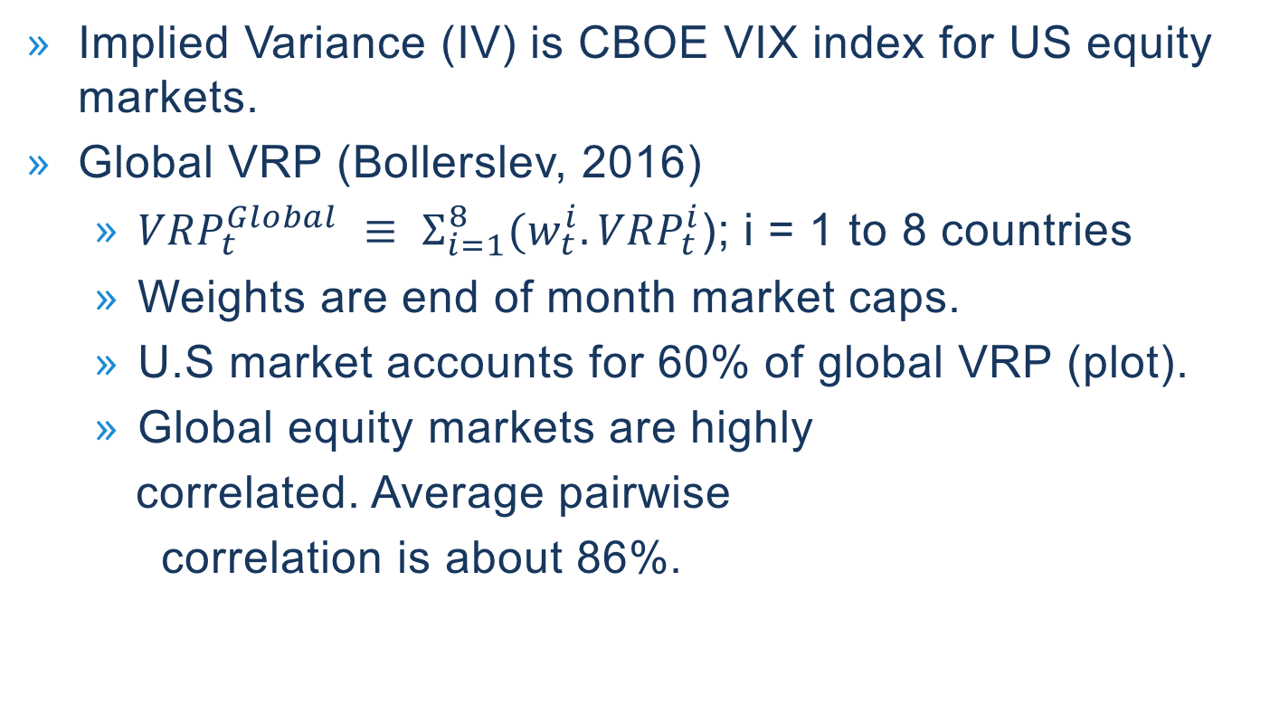
VRP - PROXY
Implied Variance (IV) is CBOE VIX index for US equity markets.
Global VRP (Bollerslev, 2016)
${VRP}_{t }^{Global}$ $≡ Σ_{i=1}^{8}{(w}_{t}^{i}.{VRP}_{t}^{i}$); i = 1 to 8 countries
Weights are end of month market caps.
U.S market accounts for 60% of global VRP (plot).
Global equity markets are highly
correlated. Average pairwise
correlation is about 86%.

Slide 23
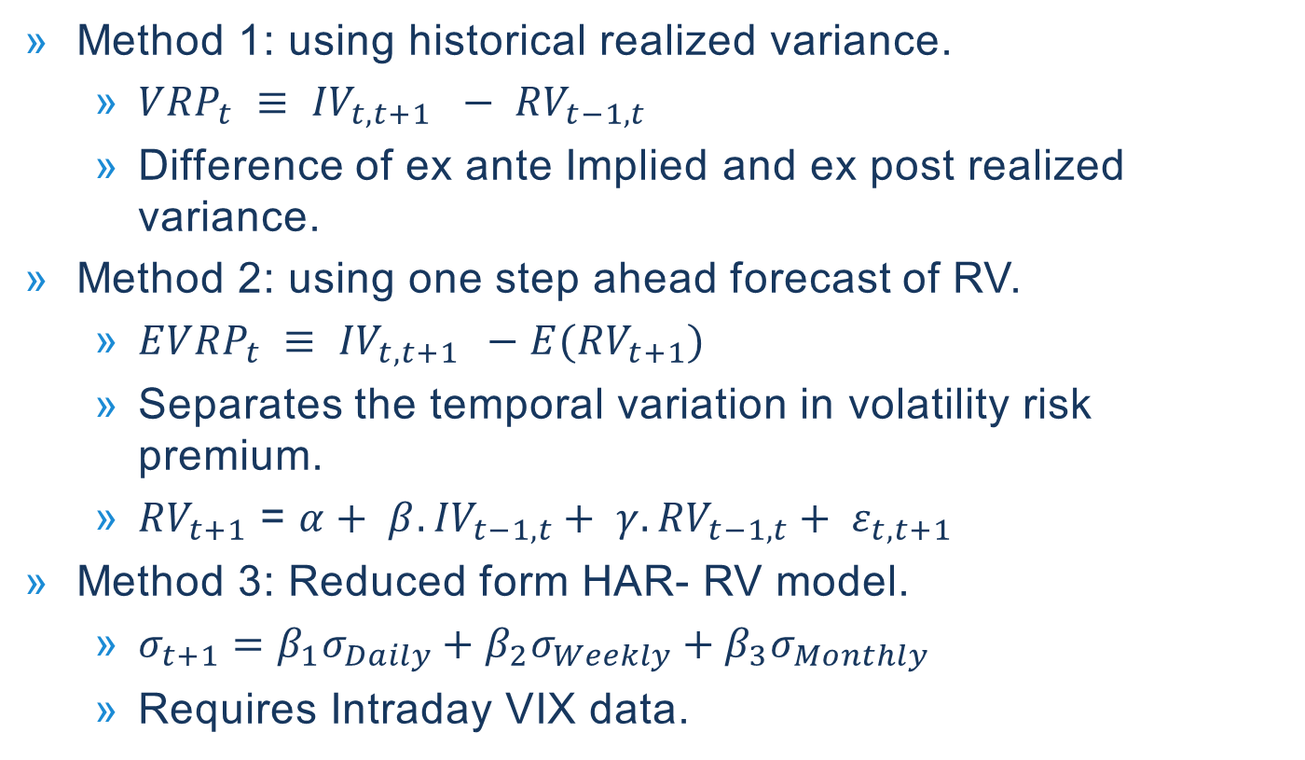
Methods-calculating vrp
Method 1: using historical realized variance.
${VRP}_{t} ≡ {IV}_{t,t+1} − {RV}_{t−1,t}$
Difference of ex ante Implied and ex post realized variance.
Method 2: using one step ahead forecast of RV.
${EVRP}_{t} ≡ {IV}_{t,t+1 } −E({RV}_{t+1})$
Separates the temporal variation in volatility risk premium.
${RV}_{t+1}$ = $α+ β.{IV}_{t−1,t}+ γ.{RV}_{t−1,t}+ ε_{t,t+1}$
Method 3: Reduced form HAR- RV model.
$σ_{t+1}=β_{1}σ_{Daily}+β_{2}σ_{Weekly}+β_{3}σ_{Monthly}$
Requires Intraday VIX data.
Notes:
RV t+1 --> reduced form time series model

Slide 24
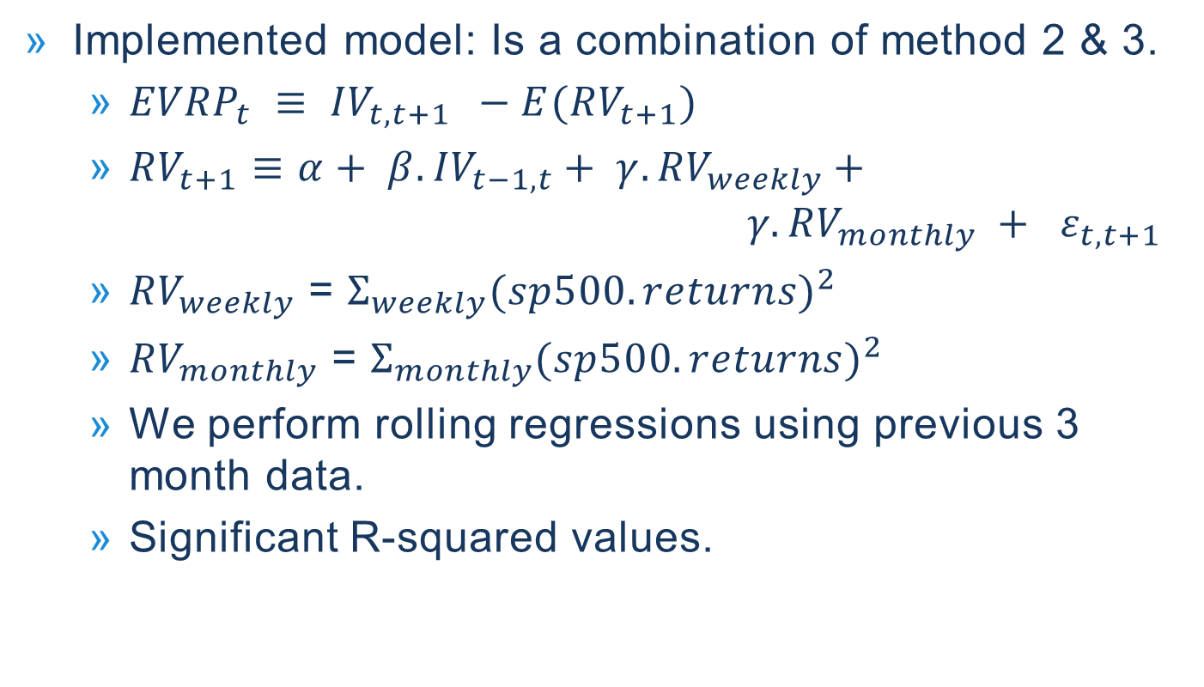
calculating vrp
Implemented model: Is a combination of method 2 & 3.
${EVRP}_{t} ≡ {IV}_{t,t+1 } −E({RV}_{t+1})$
${RV}_{t+1}$ $≡$ $α+ β.{IV}_{t−1,t}+ γ.{RV}_{weekly}+ {γ.{RV}_{monthly} + ε}_{t,t+1}$
${RV}_{weekly}$ = $Σ_{weekly}{(sp500.returns)}^{2}$
${RV}_{monthly}$ = $Σ_{monthly}{(sp500.returns)}^{2}$
We perform rolling regressions using previous 3 month data.
Significant R-squared values.

Slide 25
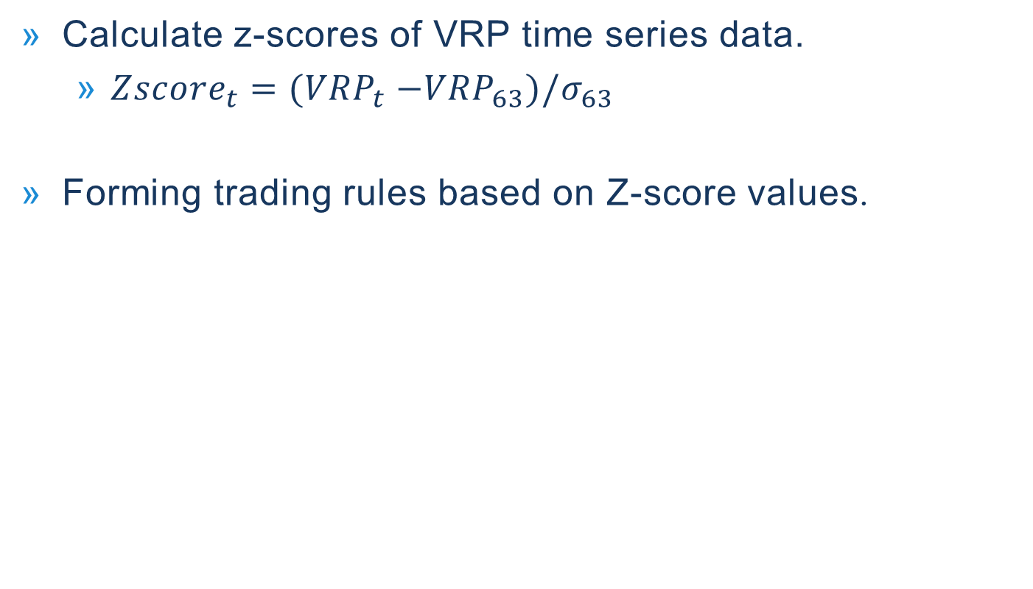
calculating vrp (continued)
Calculate z-scores of VRP time series data.
${Zscore}_{t}={(VRP}_{t} −{VRP}_{63})/σ_{63}$
Forming trading rules based on Z-score values.

Slide 26
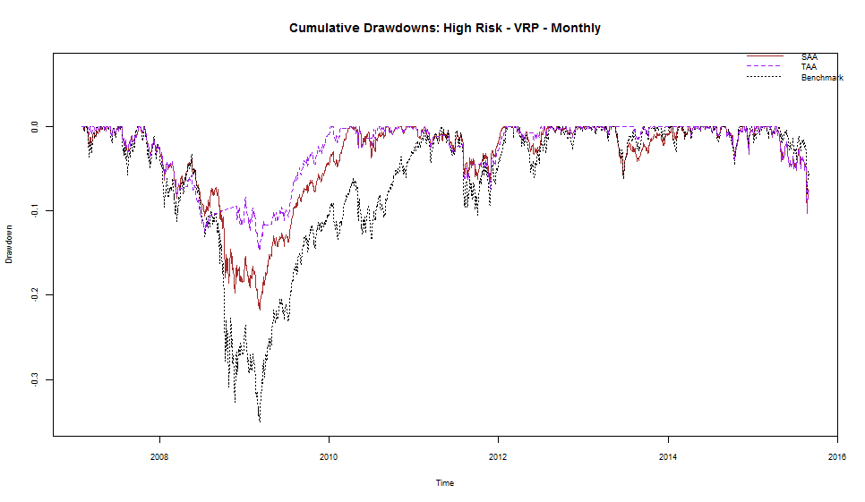
In sample High risk Individual VRP

Slide 27
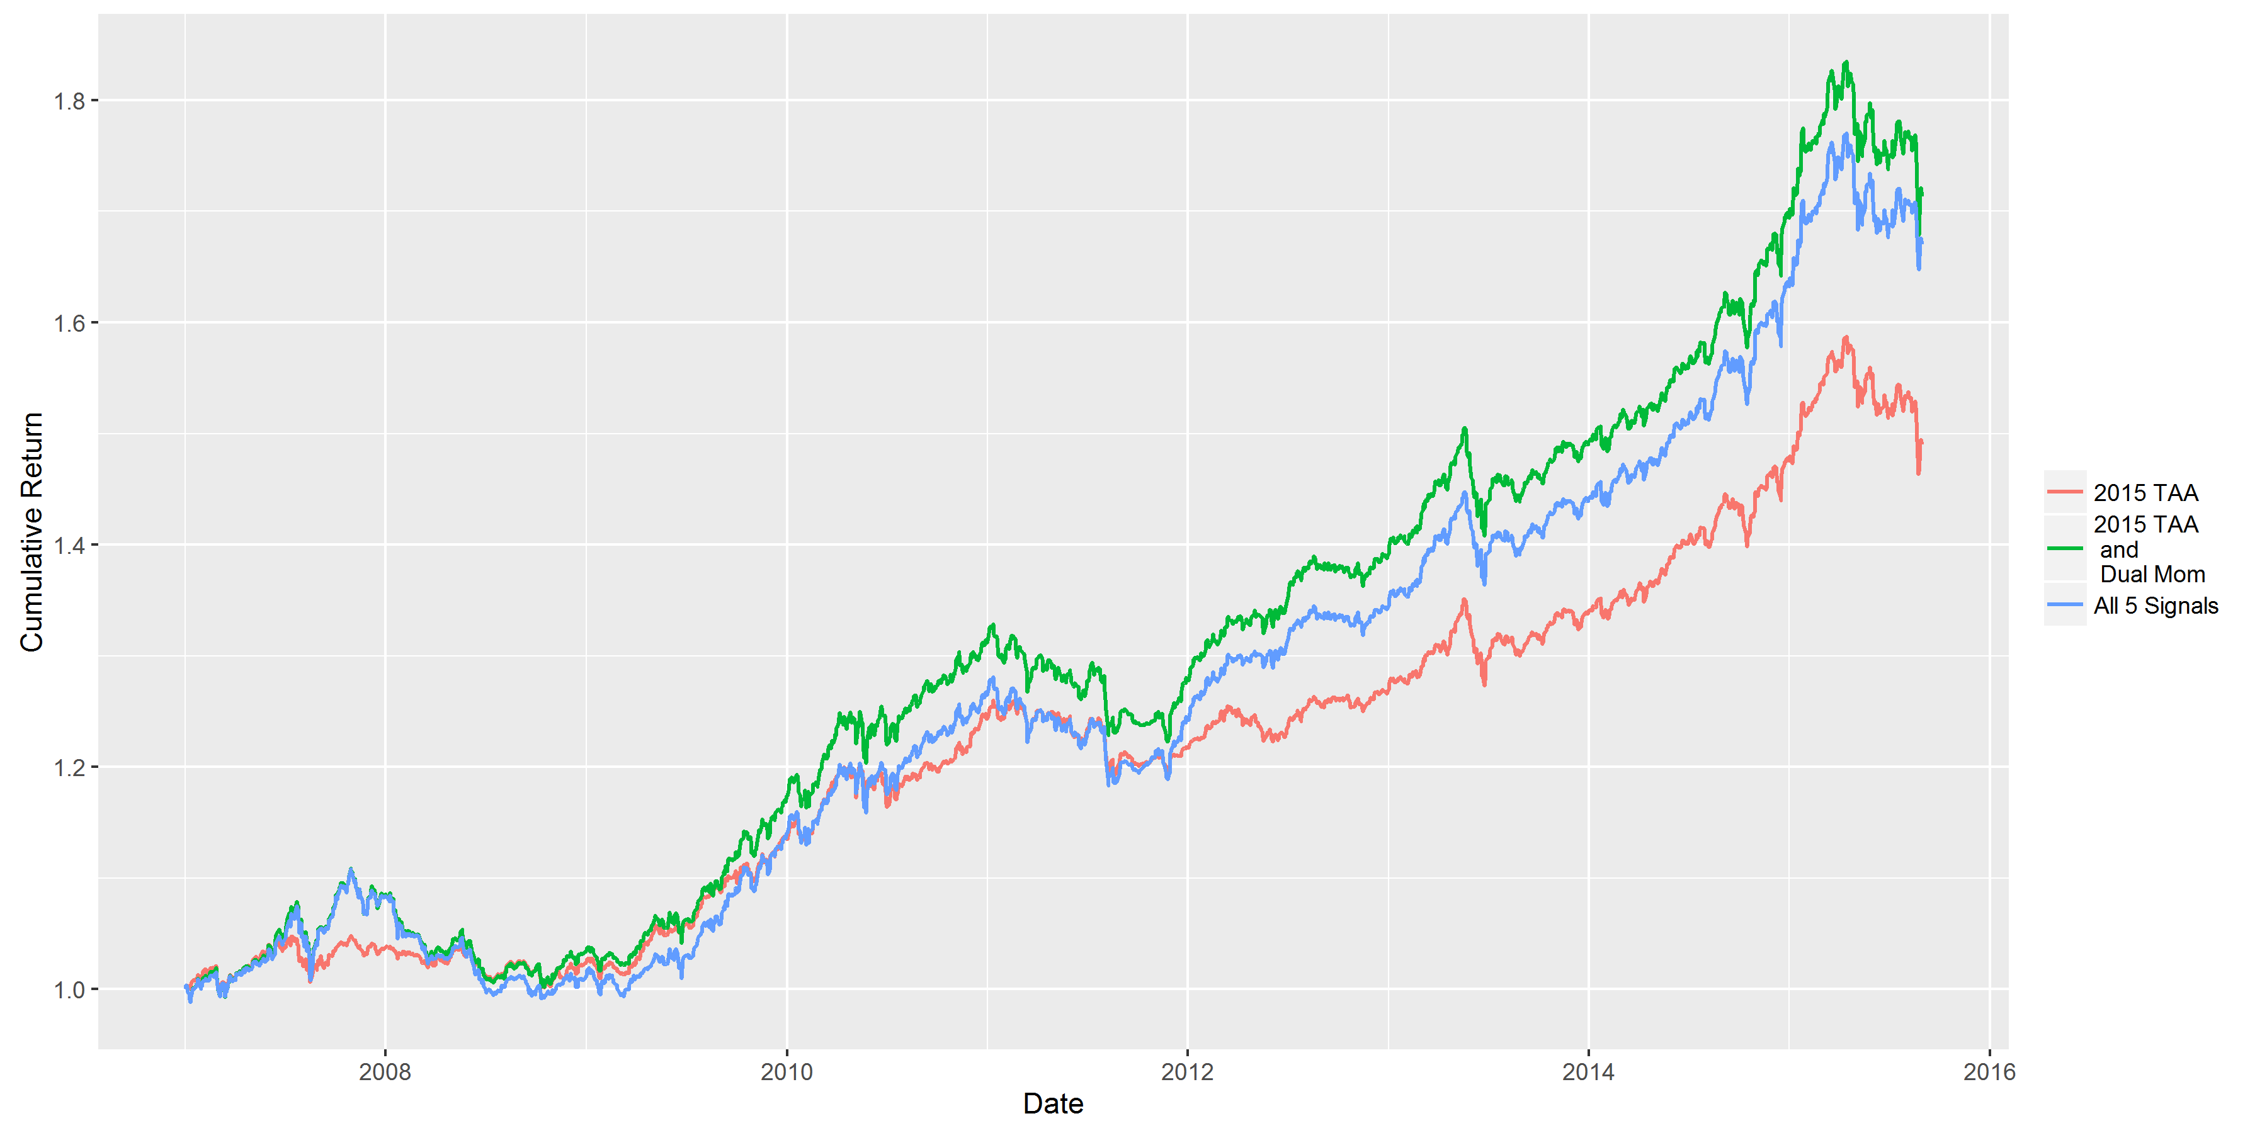
In Sample high risk combined vrp

Slide 28
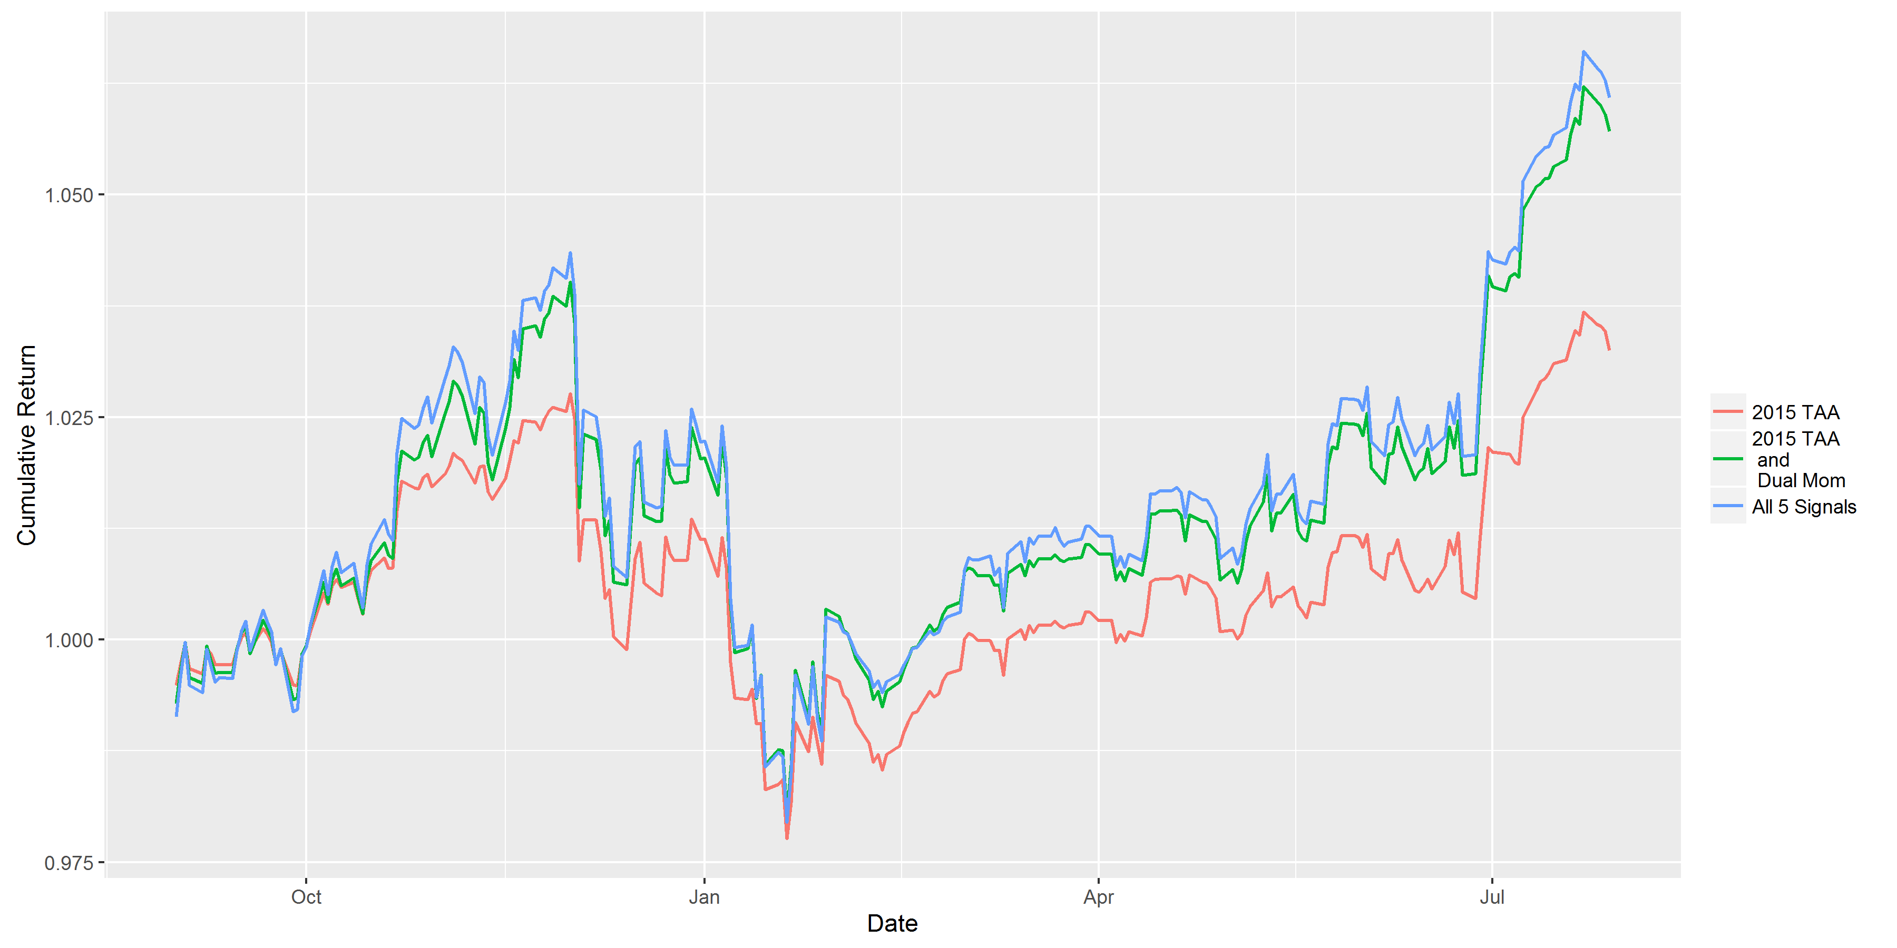
Out of sample high risk combined

Slide 29
CONTENTS
Background
Objective
Added Signals
Dual Momentum
Variance Risk Premium
Conclusion

Slide 30
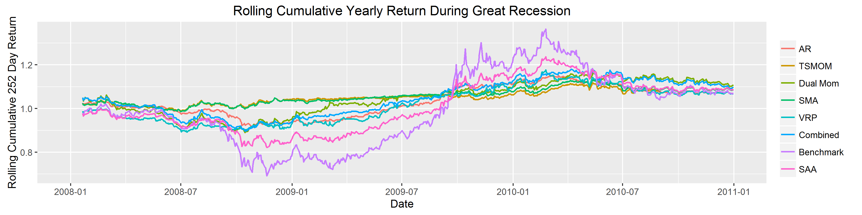
Summary of in sample results

Slide 31
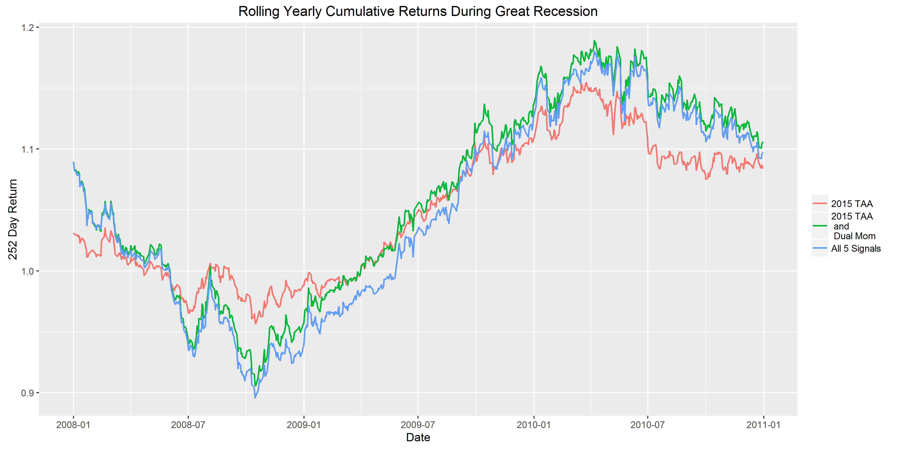
Summary of in sample results (continued)

Slide 32
Problem: too many signals
Correlations of individual high risk signal portfolios
Signals are highly correlated!
Limit to how much value these signals can add

Slide 33
conclusion
Dual Momentum adds value but VRP does not
Adding too much contrarian signals does not add value
Ideas for Future Improvements:
Find two to three signals that work the best and use those as your main signals in the strategy
Use other signals to modulate your main signals
Adjust signals to participate in upside as well as downside
Improve VRP regression

Slide 34
Application: Vix Modulator on dual momentum
Adding VIX modulator to dual momentum improves performance.
Higher returns
Lower volatility
Higher Sharpe ratio
Lower maximum drawdown

Slide 35
Thanks!

